Slide 1

Dynamic Memory Allocation in C++
Code using C++
Q & A

Slide 2
DMA
int a[5] = {1,2}; // memory wastage
int a[2] = {10,20,30}; // memory shortage
DMA – User decides required number of bytes in run time.
int *ptr = new int[size];
Notes:
In realloc(), malloc, calloc(), the return data type is VOID
Here, alloc.h
Here, we use NEW operator– implicit typecasting
No header file
All Dynamic operations - the memory is done in HEAP.
Until prog is closed or free() or
In C++ delete operator

Slide 3
Memory allocation
The stack − All variables declared inside the function will take up memory from the stack.
The heap − This is unused memory of the program and can
be used to allocate the memory dynamically when
program runs.

Slide 4
Memory allocation representation
#include<iostream>
using namespace std;
int main()
{
int *p;
float *q;
char *r;
p=new int(10);
q=new float(1.5);
r=new char('X’);
delete p;
delete q;
delete r;
}
Stack | Heap
Notes:
New operator is used- we shud declare pointer

Slide 5
Memory allocation representation-ARRAYS
#include<iostream>
using namespace std;
int main()
{
int size;
cout<<"Enter array size";
cin>>size; // 3 as size
int *p=new int[size];
for(int i=0;i<size;i++)
{
cin>>p[i];
}
cout<<endl;
for(int i=0;i<size;i++)
{
cout<<p[i]<<" ";
}
cout<<endl;
delete p;
}
Stack | Heap
Notes:
New operator is used- we shud declare pointer

Slide 6
Double pointers
Double Pointer (Pointer to Pointer) in C++
We already know that a pointer points to a location in memory and thus used to store the address of variables. So, when we define a pointer to pointer. The first pointer is used to store the address of the variable. And the second pointer is used to store the address of the first pointer. That is why they are also known as double pointers.
How to declare a pointer to pointer in C++? Declaring Pointer to Pointer is like declaring pointer in C++.
The difference is we must place an additional ‘*’ before the name of pointer.
Syntax:
int **ptr; // declaring double pointers

Slide 7
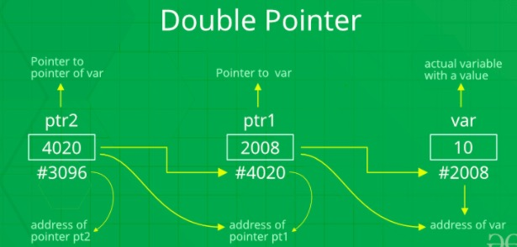

Slide 8
Memory allocation representation-2D ARRAYS
#include<iostream>
using namespace std;
int main()
{
int **ptr, size_row, size_col, row, col;
cout<<"enter row & col size";
cin>>size_row>>size_col; // row-2 and col-3
ptr=new int *[size_row];
for(row=0;row<size_row;row++)
{
ptr[row]=new int[size_col];
}
cout<<"enter element"<<endl;
for(row=0;row<size_row;row++)
{
for(col=0;col<size_col;col++)
{
cin>>ptr[row][col];
}
}
for(row=0;row<size_row;row++)
{
for(col=0;col<size_col;col++)
{
cout<<ptr[row][col]<<endl;
}
cout<<endl;
}
delete ptr;
}
Stack | Heap
Notes:
New operator is used- we shud declare pointer

Slide 9
Thank You

